Slide 1

GIT Training

Slide 2

Agenda
What is GIT?
Command Line Interpreter
Setting up Git and GitHub
Git: Hands on Work
GitHub Branches
More Advanced Topics

Slide 3
Agenda
What is GIT?
- What is a Software Repository?
- Local and Remote Repositories
- Git Workflow
Command Line Interpreter
Setting up Git and GitHub
Git: Hands on Work
GitHub Branches
More Advanced Topics

Slide 4

What is a Software Repository?
A software repository is a storage location for software files/packages.
A repository can contain various types of things:
- Data files (e.g., csv and json)
- Codes (e.g., Python and R)
- Images, word files, notes …
A software repository is typically managed by source control or repository managers.

Slide 5

Question
How do you manage your files (e.g., pictures)?
Where do you store them? Do you make copies?
How do you make sure you won’t lose them?

Slide 6

Question
How do you manage your files (e.g., pictures)?
Where do you store them? Do you make copies?
How do you make sure you won’t lose them?
Let’s say you go to a road trip with your friends
How do collect all the images from everybody?
What if someone deletes an image from the shared folder?

Slide 7

Question
How do you manage your files (e.g., pictures)
Where do you store them? Do you make copies?
How do you make sure you won’t lose them?
Some files are
too important to lose!
What happens after a road trip?
How do collect all the images from everybody?
What if someone deletes an image from the shared folder.

Slide 8

Question
How do you manage your files (e.g., pictures)
Where do you store them? Do you make copies?
How do you make sure you won’t lose them?
Some files are
too important to lose!
Git can save you!
What happens after a road trip?
How do collect all the images from everybody?
What if someone deletes an image from the shared folder.

Slide 9
What is GIT?
Global Information Tracker
Git tracks the changes you make to files, so you have a record of what has been done. If you mess up, you can usually recover your stuff
Git is a version control system used for coordinating work among programmers
Allows you to revert the files to specific versions
Notes:
It stands for “Global Information Tracker”
Git tracks the changes you make to files, so you have a record of what has been done. This is very important because you will be making mistakes and you would want to know how revert the changes to a previous version. We talked about this shortly last time but let’s see how it works on Google Doc. Go To Google Doc.
Git is a version control system used for coordinating work among programmers. When you work on files by yourself you have the freedom to do whatever you want but it doesn’t work like that when you work on the files with other people. Some people are messy, they don’t follow the protocols or rules and it can create issues. For example, you can work on a file for a month and the can come and just overwrite it with some other information. We can’t let this happen :)
If needed you to revert the files to specific versions.
So this is great, right? Thanks to GitHub, you will never break anything. You can always go back to a previous state and save your work.

Slide 10
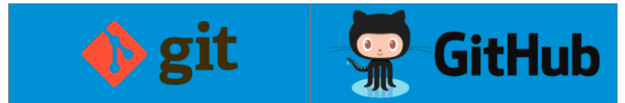
GIT and GitHub
Very similar but there are some small differences. People sometimes you them interchangeably
Git is a software and installed locally on your computer
- You need to write some codes/scripts for Git
GitHub is a website and hosted on Web. GitHub provides a web interface that allows you to manage your code/files etc.
You will learn about both of them
- We will install Git on your computers and then a GitHub account
- Next, we are going to connect them to each other

Slide 11
GIT and GitHub
GitHub is also an ocean of resources!
First, let’s see some sample accounts:
https://github.com/arjunmann73/Data-Analytics-Projects
https://github.com/DonJayamanne/data-science

Slide 12
Agenda
What is GIT?
- What is a Software Repository?
- Local and Remote Repositories
- Git Workflow
Command Line Interpreter
Setting up Git and GitHub
Git: Hands on Work
GitHub Branches
More Advanced Topics

Slide 13

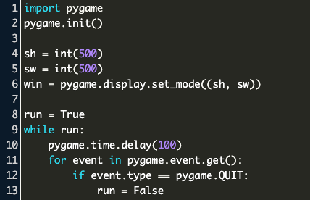
Local vs Remote Repositories
You
Notes:
The idea is pretty simple: We all have some local files and also some shared files on the cloud. For example, if you have a word file on your computer, it is local. But if you take that file and convert it to a google doc and then share it with other people, it is now remote now
CLICK
It is the same idea with repositories. CLICK

Slide 14
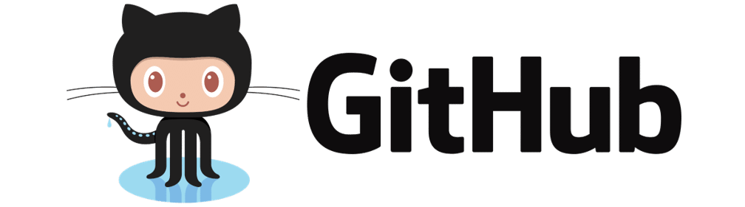
Local vs Remote Repositories
You

Slide 15
Local vs Remote Repositories
You

Slide 16
Local vs Remote Repositories
You

Slide 17

Local vs Remote Repositories
You

Slide 18
Agenda
What is GIT?
- What is a Software Repository?
- Local and Remote Repositories
- Git Workflow
Command Line Interpreter
Setting up Git and GitHub
Git: Hands on Work
GitHub Branches
More Advanced Topics

Slide 19

Git Workflow
Main

Slide 20
Git Workflow
Main

Slide 21
Git Workflow
Main

Slide 22
Git Workflow
Main

Slide 23
Git Workflow
Main

Slide 24
Git Workflow
Main

Slide 25


To Git or not to Git?
That is no question!
But how?
Let’s git our hands dirty! :)

Slide 26
Agenda
What is GIT?
Command Line Interpreter
- What is a Command Line Interpreter?
- Basic Commands
Setting up Git and GitHub
Git: Hands on Work
GitHub Branches
More Advanced Topics

Slide 27
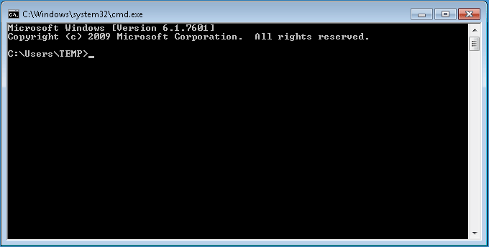
Command Line Interpreter
A communication portal between you and your computer. It provides a direct interaction with your computer
We don’t always have an available program/software to handle things for us, so we connect to the computer directly
It is your best friend when you install programs and manage packages/libraries etc

Slide 28
Command Line Interpreter
Windows
* Often referred as “Command Prompt” or “CMD”

Slide 29
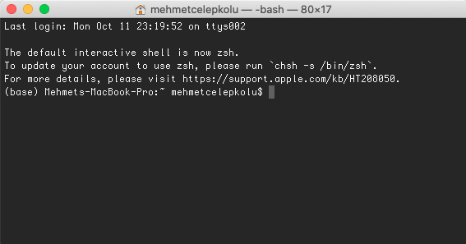
Command Line Interpreter
Windows
Mac OS
* Often referred as “Command Prompt” or “CMD”
* Often referred as “Terminal”

Slide 30
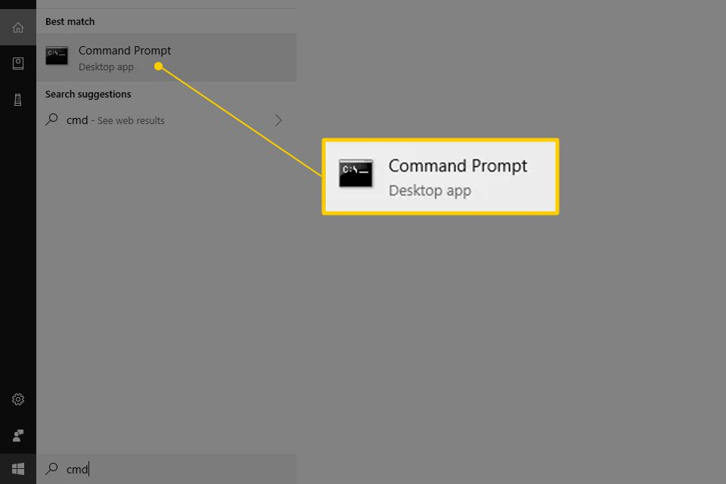
Command Line Interpreter: Windows
Type "command prompt” or ”cmd" into the Start menu

Slide 31
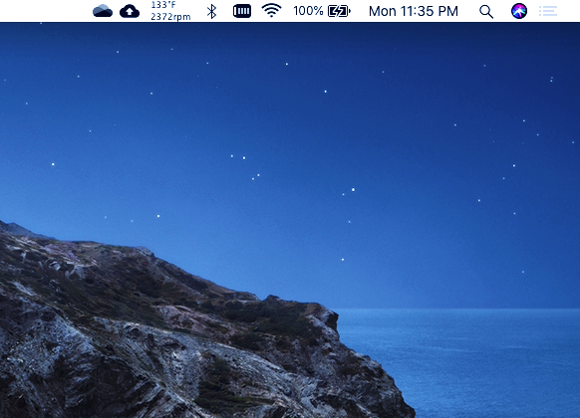
Command Line Interpreter: Mac OS
Click on the Spotlight button in the menu bar (looks like a magnifying glass)
Type “terminal”

Slide 32
Command Line Interpreter: Basic Commands
Command | Description | Sample Use
cd | ”Change Directory" or, in simpler terms, change which folder we are in | cd desktop cd downloads
ls | It shows everything in a folder. | Ls or DIR /W
clear | It "clears" the screen | Clear or CLS
mkdir | "Make Directory" or simply, make a new folder. | mkdir newFolder mkdir “Name”
cd .. | Will move the user up one directory. So, if you are in the .../myPictures/RoadTrip directory, it will take you to .../myPictures directory. | • cd ..

Slide 33

Practice Time!
Breakout Rooms (2-3 people)
Go to you command prompt (or terminal)
Go to your desktop
Create a folder named “My Project Folder”
Put/Copy some files in the My Project Folder (manually)
Print/Show the files in the “My Project Folder”
Clear the screen
Use the cd.. command

Slide 34
Agenda
What is GIT?
Command Line Interpreter
Setting up Git and GitHub
- Setting up GIT on your local computer
- Creating a GitHub account
- Connecting your local computer with GitHub
Git: Hands on Work
GitHub Branches
More Advanced Topics

Slide 35
Git Installation
Windows: https://git-scm.com/download/win
- Download the program and install it
Mac: https://git-scm.com/download/mac
- Install homebrew: /bin/bash -c "$(curl -fsSL https://raw.githubusercontent.com/Homebrew/install/HEAD/install.sh)”
- brew install git

Slide 36
Git Installation
After installation, type the following command on your command window (for windows) or terminal (for Mac). git --version
The output will be something like this: git version 2.28.0
If Git is not installed, you will get the following error:
-bash: git: command not found

Slide 37
GitHub Account Creation
We have installed Git on our local computers
Now, it is time to create an account on GitHub to manage remote repositories
Go to: https://github.com/
Create an account
Post your profile link to the #class-chat Slack channel. Follow each other
Now, let’s create a project

Slide 38
Connecting your local computer with GitHub
SSH Connection: Link (clip should be cat)
Create Personal Access Token on GitHub Link
We are ready!

Slide 39
Agenda
What is GIT?
Command Line Interpreter
Setting up Git and GitHub
- Setting up GIT on your local computer-
- Creating a GitHub account
- Connecting your local computer with GitHub
Git: Hands on Work
GitHub Branches
More Advanced Topics

Slide 40
Agenda
What is GIT?
Command Line Interpreter
Setting up Git and GitHub
Git: Hands on Work
- Creating Projects
- Cloning Projects
- Add/Commit/Push
GitHub Branches
More Advanced Topics

Slide 41
Creating Your First Project on GitHub
Create a project on GitHub
Clone it to your local computer
Check files
Modify files
Connect local and remote
- git remote add origin git@github.com:username/repoName.git
- sudo git remote set-url origin https://<token>@github.com/username/directory-name.git
Push it back
- git status
- git add XYZ
- git commit -m “my message”
- git push

Slide 42
Using/Copying a Project from GitHub
Never steal someone else’s work!
You can “Fork” the project, which will create a copy on your GitHub while still giving the credits to the original owner
You can make any changes after your fork the project.
Do not forget to set the origin with your token
- sudo git remote set-url origin https://<token>@github.com/username/directory-name.git

Slide 43
Practice Time!
Breakout Rooms (2-3 people)
Create a new Project on GitHub
Clone it to your local repository
Modify some files
Push them back to your remote repository
Now find some data analytics projects on Github and fork them to your GitHub
Do steps 3-4

Slide 44
Agenda
What is GIT?
Command Line Interpreter
Setting up Git and GitHub
Git: Hands on Work
- Creating Projects
- Cloning Projects
- Add/Commit/Push
GitHub Branches
More Advanced Topics

Slide 45
Agenda
What is GIT?
Command Line Interpreter
Setting up Git and GitHub
Git: Hands on Work
GitHub Branches
- Creating a branch
- Pull Request
- Merge Code
More Advanced Topics

Slide 46


